Slide 1




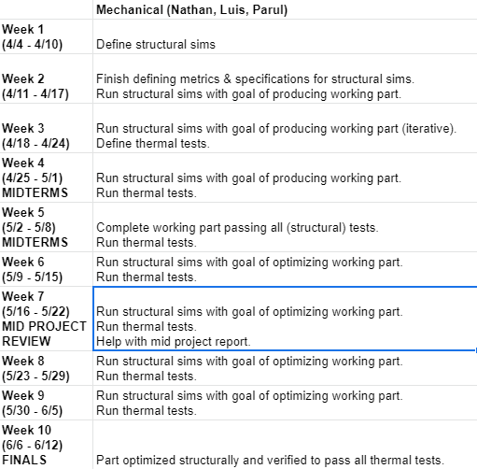
Validation
Schedule (Structural)
4/9/21
Nathan, Luis
Budget = $0
Need – confirmation of which materials (and thicknesses) will be possible to manufacture (Mechanical Team)
Need – maximum thicknesses for the top plate, possibility of adding metal plate under bottom panel (Electrical Team)

Slide 2
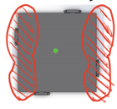
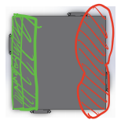


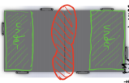
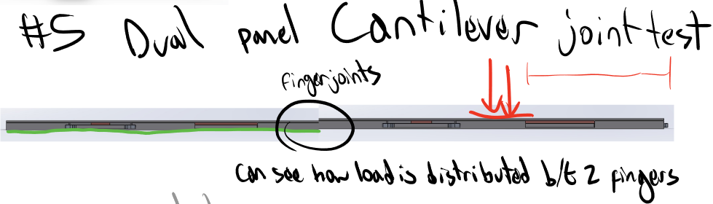
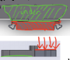
Validation
Structural Tests/Sims
4/9/21
Luis, Nathan
Planned structural tests
Whole Panel Tests
Three-point bend
Cantilever
Multiple Panel Tests
Dual Panel Three-point bend
Dual Panel Cantilever
Finger Joint Tests (sanity check)
Link
Loads (shown in red) are 486 N total
Fixed points shown in green

